Slide 1
Farming Assistance Service
Project Progress Report I
Himanshu Singh Chauhan (2101220100054)
Aviral Jaiswal (2101220100035)

Slide 2
Content
Project Objective
Project Methodologies
Modules
Work Completed
Work of Progress

Slide 3
Project Objective
To develop and create a digital platform that provides valuable support and resources to the farmers, agricultural workers, and stakeholders in the agricultural industry which could address various challenges and needs within the farming sector.
To facilitate connections between farmers and potential buyers such as wholesalers, retailers and consumers.
To reduce the cost and develop an economical and user-friendly GUI application.
To provide suggestions based on a current world to eliminate the need to translate the full term.

Slide 4
Project Methodologies
Here's a concise overview of how the Iterative Waterfall model applies to the Farming Web Assisting Services project:
Requirements Analysis:
Gather and refine user requirements through iterative feedback.
System Design:
Create a solid design, tested and refined in iterations.
Implementation:
Develop features in phases, adjusting based on continuous feedback.
Testing:
Test early and throughout development, refining as needed.
Deployment:
Deploy the system, then refine with incremental updates.
Maintenance:
Continuously improve the system with regular updates based on evolving needs.

Slide 5
Work Completed
The User Login frontend module is ready.
The authentication page has been designed.
The welcome page is designed.
The dataset have been taken for the right predictions.
The frontend part is 48% ready.

Slide 6
Authentication Module
A farming web assistant service built in Python can be a comprehensive platform to assist farmers by providing crucial resources, tools, and services. It can address challenges like resource management, crop information, weather prediction, pest control, and market access. Below is a detailed description of how such a service can be designed and implemented, focusing on key components and functionality.
User Authentication and Profiles:
To ensure secure and personalized services for farmers, an authentication system can be implemented. Farmers need to log in to access tailored information and tools.
User Authentication:
Use libraries like Django's built-in authentication system to enable farmers to sign up using email or phone numbers, with password protection, email verification, and secure logins.
Third-party login options (OAuth) can be provided for social media or Google login

Slide 7
Work of Progress
The work on maintaining the database has been started.
The listing of the products has to be made.
Working on other modules as well.

Slide 8
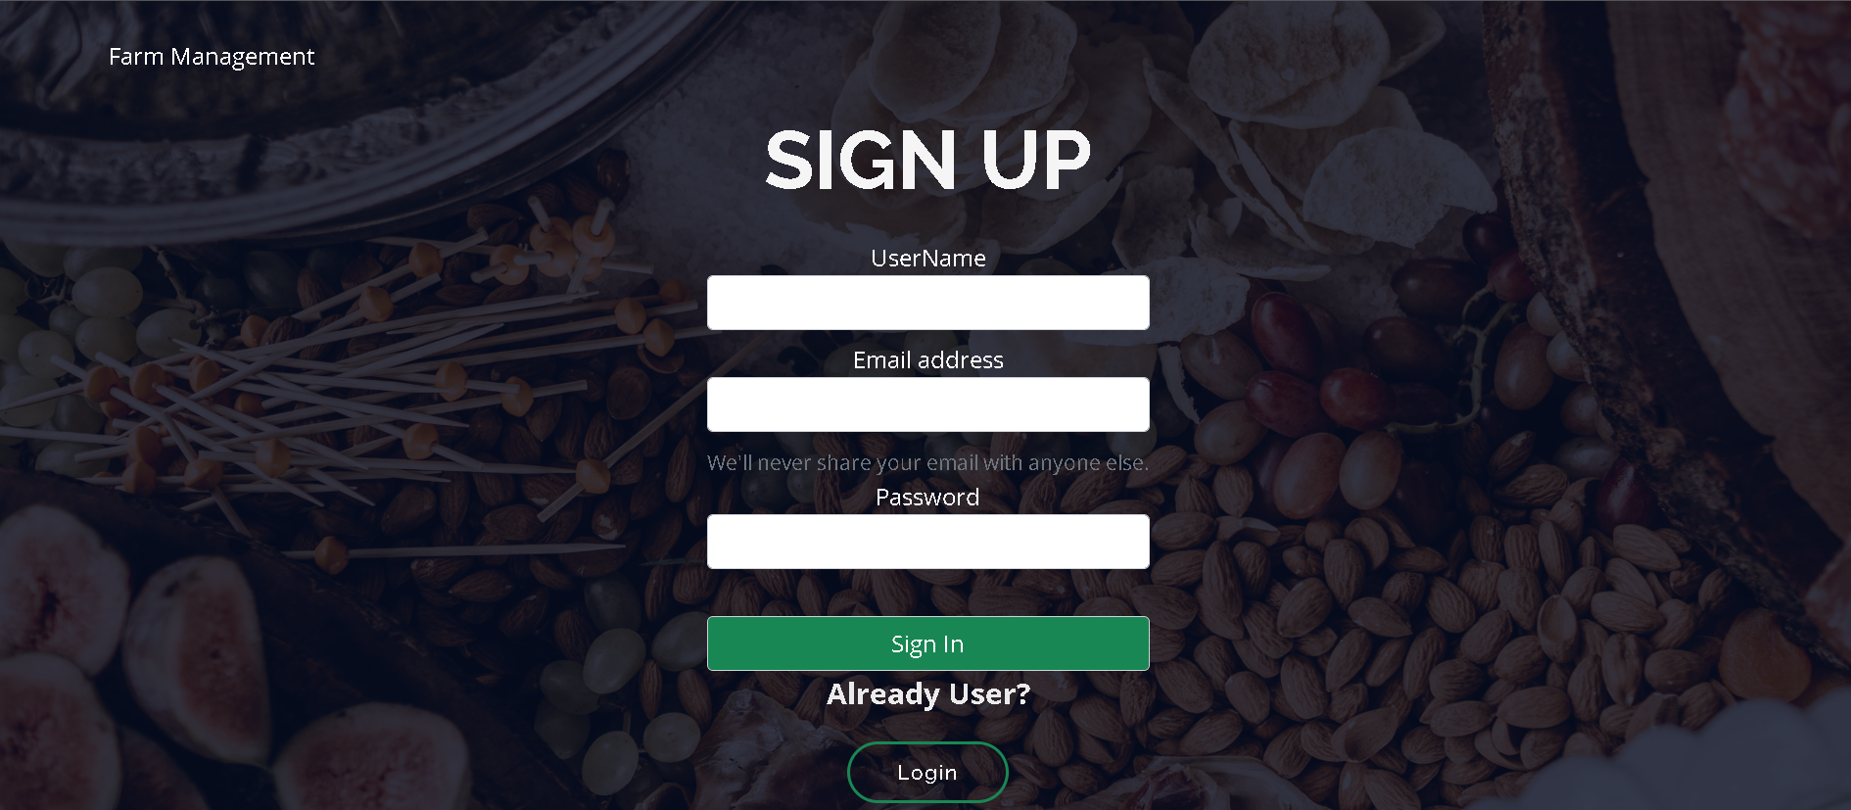
Authentication Page Interface

Slide 9
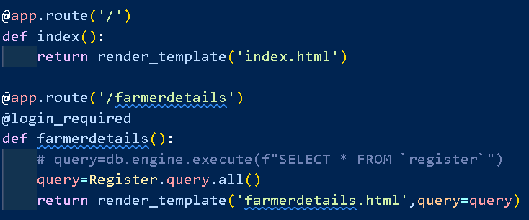
Login Page Module

Slide 10
Work Completed:- 1.The dataset is taken from the Kaggle and is being optimized for the accurate and precise predictions. 2. The work done is 38% 3. Next thing we’ll be designing the adding of items and farmer information 4.The connectivity of the data and source will be done through XAMPP

Slide 11
Difficulties Occurred
Facing error in recently designed modules.
Facing problem in linking and checking the authenticity of farmers ID.
Interfacing issues.

Slide 12
THANK YOU

